Slide 1

Line Graphs
Study the following line graph and answer the questions.
Exports from Three Companies Over the Years ( in ₹. Crore)

Slide 2
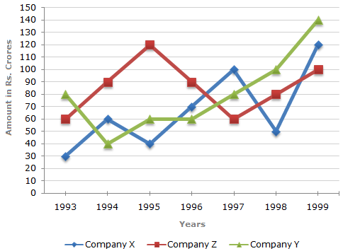
Line graphs
Study the following line graph and answer the questions.
Exports from Three Companies Over the Years (in Rs. crore)

Slide 3
Exercise
For which of the following pairs of years the total exports from the three Companies together are equal?
1995 and 1998
1996 and 1998
1997 and 1998
1995 and 1996

Slide 4
Exercise
Year X Y Z Total
1993 30 80 60 170
1994 60 40 90 190
1995 40 60 120 220
1996 70 60 90 220
1997 100 80 60 240
1998 50 100 80 230
1999 120 140 100 360
Total 470 560 600 1630

Slide 5
Exercise
Average annual exports during the given period for Company Y is approximately what percent of the average annual exports for Company Z?
87.1%
89.64%
91.21%
93.33%

Slide 6
Exercise
In which year was the difference between the exports from Companies X and Y the minimum?
1994
1995
1996
1997

Slide 7
Exercise
What was the difference between the average exports of the three Companies in 1993 and the average exports in 1998?
Rs . 15.33 crores
Rs. 18.67 crores
Rs. 20 crores
Rs. 22.17 crores

Slide 8
Exercise
In how many of the given years, were the exports from Company Z more than the average annual exports of Z over the given years?
A) 2
B) 3
C) 4
D) 5

Slide 9
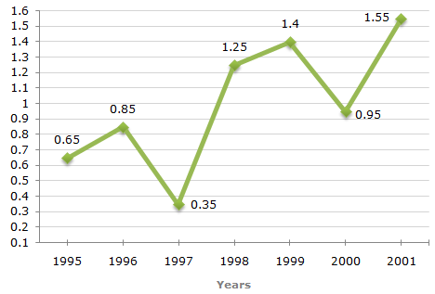
Exercise
Ratio of Value of Imports to Exports by a Company Over the Years

Slide 10
Exercise
If the imports in 1998 was Rs. 250 crores and the total exports in the years 1998 and 1999 together was Rs. 500 crores, then the imports in 1999 was?
Rs. 250 crores
Rs. 300 crores
Rs 357 crores
Rs 420 crores

Slide 11
Exercise
The imports were minimum proportional to the exports of the company in the year ?
A) 1995
B) 1996
C) 1997
D)2000

Slide 12
Exercise
What was the percentage increase in imports from 1997 to 1998?
A) 72
B) 56
C) 28
D) Date inadequate

Slide 13
Exercise
If the imports of the company in 1996 was Rs 272 crores, the exports from the company in 1996 was?
Rs. 370 crores
Rs. 320 crores
Rs. 280 crores
Rs. 275 crores

Slide 14
Exercise
In how many of the given years were the exports more than the imports?
A) 1
B) 2
C) 3
D) 4

Slide 15
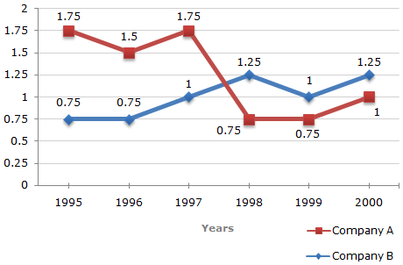
Exercise
Ratio of Exports to Imports (in terms of money in Rs. Crores) of Two Companies Over the Years

Slide 16
Exercise
In how many of the given years were the exports more than the imports for Company A?
2
3
4
5

Slide 17
Exercise
Year | Company A | Company B
1995 19961998 1999 2000 | 1.75 1.50 1.75 0.75 0.75 1.00 | 0.75 0.75 1.00 1.25 1.00 1.25

Slide 18
Exercise
If the imports of Company A in 1997 were increased by 40%, what would be the ratio of exports to the increased imports?
A) 1.20
B) 1.25
C)1.30
D)Cannot be determined

Slide 19
Exercise
If the exports of Company A in 1998 were Rs. 237 crores, what was the amount of imports in that year?
A) Rs. 189.6 crores
B) Rs. 243 crores
C) Rs. 281 crores
D) Rs. 316 crores

Slide 20
Exercise
In 1995, the exports of Company A was double that of Company B. If the imports of Company A during the year was RS. 180 crores, what was the approximate amount of imports of Company B during that year?
Rs 190 crores
Rs 210 crores
Rs 225 crores
Cannot be determined

Slide 21
Exercise
In which years was the difference between imports and exports of Company B the maximum?
A) 2000
B) 1996
C) 1998 and 2000
D) Cannot be determined

Slide 22
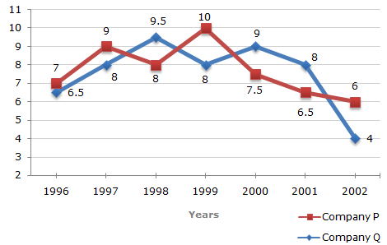
Exercise
Two difference finance companies declare fixed annual rate of interest on the amounts invested with them by investors. The rate of interest offered by these companies may differ from year to year depending on the variation in the economy of the country and the banks rate of interest. The annual rate of interest offered by the two Companies P and Q over the years re shown by the line graph provided below.
Annual Rate of Interest Offered by Two Finance Companies Over the Years

Slide 23
Exercise
. A sum of ₹ 4.75 lakhs was invested in Company Q in 1999 for one year. How much more interest would have been earned if the sum was invested in Company P?
A) ₹ 19,000
B) ₹ 14,250
C) ₹ 11,750
D) ₹ 9500
Year | P | Q
1996 | 7 | 6.5
1997 | 9 | 8
1998 | 8 | 9.5
1999 | 10 | 8
2000 | 7.5 | 9
2001 | 6.5 | 8
2002 | 6 | 4

Slide 24

exercise
The investment = 4.75 lakhs
Year : 1999 P : 10% Q : 8%
The interest earned more = $\frac{4.75 x {10}^{5} x 1 x 2}{100}$ = Rs. 9,500

Slide 25
Exercise
. If two different amounts in the ratio 8 : 9 are invested in Companies P and Q respectively in 2002, then the amounts received after one year as interests from Companies P and Q are respectively in the ratio?
A) 2 : 3
B) 3 : 4
C) 6 : 7
D) 4 : 3
year | P | Q
1996 | 7 | 6.5
1997 | 9 | 8
1998 | 8 | 9.5
1999 | 10 | 8
2000 | 7.5 | 9
2001 | 6.5 | 8
2002 | 6 | 4

Slide 26

exercise
Investment ratio = P : Q = 8x : 9x
In 2002 P : 6% Q : 4%
Interest ratio P : Q = $\frac{\left(8x\right) x 1 x 6}{100}$: $\frac{\left(9x\right)x 1 x 4 }{100}$
= 8x * 6 : 9x * 4 = 4:3

Slide 27
Exercise
. In 2000, a part of ₹ 30 lakhs was invested in Company P and the rest was invested in Company Q for one year. The total interest received was ₹ 2.43 lakhs. What was the amount interest invested in Company P?
A) ₹ 9 lakhs
B) ₹ 11 lakhs
C) ₹ 12 lakhs
D) ₹ 18 lakhs
year | P | Q
1996 | 7 | 6.5
1997 | 9 | 8
1998 | 8 | 9.5
1999 | 10 | 8
2000 | 7.5 | 9
2001 | 6.5 | 8
2002 | 6 | 4

Slide 28

Exercise
Total investment = Rs.30 lakhs
Year : 2000 P: 7.5% Q: 9%
Let the investment in company P = x lakhs
Then the investment in Q = (30-x) lakhs
Total interest earned = 2.43 lakhs
-→ $\frac{ (x) x 1 x 7.5}{100}$ + $\frac{\left(30−x\right)x 1 x 9}{100}$ = 2.43
7.5x + 270 – 9x = 243
x = 18 lakhs

Slide 29
Exercise
An investor invested a sum of ₹ 12 lakhs in Company P in 1998. The total amount received after one year was re-invested in the same Company for one more year. The total appreciation received by the investor on his investment was?
A) ₹ 2,96,200
B) ₹ 2,42,200
C) ₹ 2,25,600
D) ₹ 2,16,000
year | P | Q
1996 | 7 | 6.5
1997 | 9 | 8
1998 | 8 | 9.5
1999 | 10 | 8
2000 | 7.5 | 9
2001 | 6.5 | 8
2002 | 6 | 4

Slide 30

exercise
The investment = Rs.12 lakhs
Year : 1998 Company : P rate% = 8
Interest = $\frac{12 x 1 x 8}{100}$ = 0.96 lakhs
Amount at the end of 1998 = 12.96 lakhs
Year : 1999 Company = P rate% = 10
Interest = $\frac{12.96 x 1 x10}{100}$ = 1.296 lakhs
Total interest = 1.296 + 0.960 = Rs. 2.256lakhs
= Rs. 2,25,600

Slide 31
Exercise
. An investors invested ₹ 5 lakhs in Company Q in 1996. After one year, the entire amount along with the interest was transferred as investment to Company P in 1997 for one year. What amount will be received from Company P, by the investor?
A) ₹ 5,94,550
B) ₹ 5,80,425
C) ₹ 5,77,800
D) ₹ 5,77,500
year | P | Q
1996 | 7 | 6.5
1997 | 9 | 8
1998 | 8 | 9.5
1999 | 10 | 8
2000 | 7.5 | 9
2001 | 6.5 | 8
2002 | 6 | 4

Slide 32

exercise
The investment = Rs. 5 lakhs
Year : 1996 company : Q rate% = 6.5
Interest = $\frac{5 x 1 x 6.5}{100}$ = 0.325 lakhs
amount at the end of 1996 = 5.325 lakhs
Year : 1997 company : P rate% = 9
Interest = 5.325 x 1x 9/(100) = 0.47925 lakhs
Total amount = 5.32500 + 0.47925 = 5.80425 lakhs
= Rs. 5,80,425

Slide 33
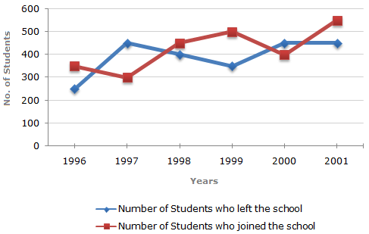
Exercise
Study the following line graph which gives the number of students who joined and left the school in the beginning of year for six years, from 1996 to 2001.
Initial strength in 1995 = 3000 students
Year | Left | Joined | Net | Strength
1996 | 250 | 350 | +100 | 3100
1997 | 450 | 300 | -150 | 2950
1998 | 400 | 450 | +50 | 3000
1999 | 350 | 500 | +150 | 3150
2000 | 450 | 400 | -50 | 3100
2001 | 450 | 550 | +100 | 3200

Slide 34
Exercise
For which year, the percentage rise/ fall in the number of students who left the school compared to the previous year is maximum?
A) 1997 Initial strength in 1995 = 3000 students
B) 1998
C) 1999
D) 2000
Year | Left | Joined | Net | Strength
1996 | 250 | 350 | +100 | 3100
1997 | 450 | 300 | -150 | 2950
1998 | 400 | 450 | +50 | 3000
1999 | 350 | 500 | +150 | 3150
2000 | 450 | 400 | -50 | 3100
2001 | 450 | 550 | +100 | 3200

Slide 35
Exercise
The strength of school increased/decreased from 1997 to 1998 by approximately what percent?
A) 1.2% Initial strength in 1995 = 3000 students
B) 1.7%
C) 2.1%
D) 2.4%
Year | Left | Joined | Net | Strength
1996 | 250 | 350 | +100 | 3100
1997 | 450 | 300 | -150 | 2950
1998 | 400 | 450 | +50 | 3000
1999 | 350 | 500 | +150 | 3150
2000 | 450 | 400 | -50 | 3100
2001 | 450 | 550 | +100 | 3200

Slide 36
The number of students studying in the school in 1998 was what percent of the number of students studying in the school in 2001?
A) 92.13%
B) 93.75%
C) 96.88%
D) 97.25%
Year | Left | Joined | Net | Strength
1996 | 250 | 350 | +100 | 3100
1997 | 450 | 300 | -150 | 2950
1998 | 400 | 450 | +50 | 3000
1999 | 350 | 500 | +150 | 3150
2000 | 450 | 400 | -50 | 3100
2001 | 450 | 550 | +100 | 3200

Slide 37
Exercise
. The ratio of the least number of students who joined the school to the maximum number of students who left the school in any of the years during the given period is?
A) 7 : 9 Initial strength in 1995 = 3000 students
B) 4 : 5
C) 3 : 4
D) 2 : 3
Year | Left | Joined | Net | Strength
1996 | 250 | 350 | +100 | 3100
1997 | 450 | 300 | -150 | 2950
1998 | 400 | 450 | +50 | 3000
1999 | 350 | 500 | +150 | 3150
2000 | 450 | 400 | -50 | 3100
2001 | 450 | 550 | +100 | 3200

Slide 38
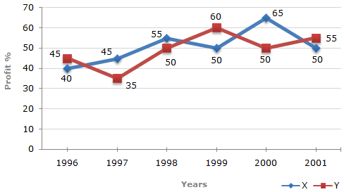
Exercise
The following line graph gives the percent profit earned by two Companies X and Y during the period 1996 - 2001.
Percentage profit earned by Two Companies X and Y over the Given Years
%Profit = | Income - Expenditure | x 100
 | Expenditure

Slide 39
Exercise
The incomes of two Companies X and Y in 2000 were in the ratio of 3:4 respectively. What was the respective ratio of their expenditures in 2000 ?
. | A) 7:22
B. | B) 14:19
C. | 15:22
D. | 27:35

Slide 40
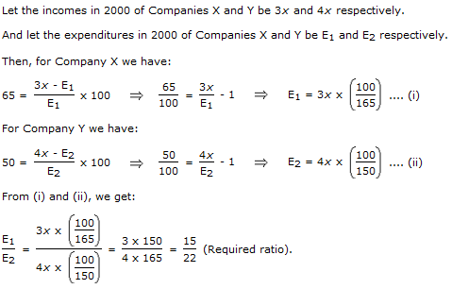
Exercise

Slide 41
Exercise
If the expenditure of Company Y in 1997 was Rs. 220 crores, what was its income in 1997?
 | A) Rs. 312 crores
B. | Rs. 297 crores
C. | Rs. 283 crores
D. | Rs. 275 crores

Slide 42

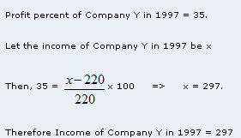



exercise

Slide 43
Exercise
If the expenditures of Company X and Y in 1996 were equal and the total income of the two Companies in 1996 was Rs. 342 crores, what was the total profit of the two Companies together in 1996?
( Profit = Income – Expenditure)
A. | Rs. 240 crores
B. | Rs. 171 crores
C. | Rs. 120 crores
D. | Rs. 102 crores

Slide 44
exercise
Let the expenditures of each of the Companies X and Y in 1996 be Rs. x crores. And let the income of Company X in 1996 be Rs. z crores so that the income of Company Y in 1996 = Rs. (342 - z) crores.
Then, for Company X we have :
40 = (z - x)/x * 100 => x = 100z/140 --- (1)
Also, for Company Y we have :
45 = [(342 - z) - x]/x * 100 => x = [(342 - z) * 100]/145 --- (2)
From (1) and (2), we get :
100z/140 = [(342 - z) * 100]/145 => z = 168 Substituting z = 168 in (1), we get :
x = 120.
Total expenditure of Companies X and Y in 1996 = 2x = Rs. 240 crores.
Total income of Companies X and Y in 1996 = Rs. 342 crores.
Total profit = Rs. (342 - 240) crores = Rs. 102 crores.

Slide 45
Exercise
The expenditure of Company X in the year 1998 was Rs. 200 crores and the income of company X in 1998 was the same as its expenditure in 2001. The income of Company X in 2001 was?
A. | Rs. 465 crores
B. | Rs. 385 crores
C. | Rs. 335 crores
D. | Rs. 295 crores

Slide 46
exercise
Let the income of Company X in 1998 be Rs. x crores. Then,
55 = (x - 200)/200 * 100 => x = 310
Expenditure of Company X in 2001
= Income of Company X in 1998
= Rs. 310 crores.
Let the income of Company X in 2001 be Rs. z crores. Then,
50 = (z - 310)/310 * 100 => z = 465
Income of Company X in 2001 = Rs. 465 crores.

Slide 47
Exercise
the incomes of two Companies were equal in 1999, then what was the ratio of expenditure of Company X to that of Company Y in 1999?
A. | 6:5
B. | 5:6
C. | 11:6
D. | 16:15

Slide 48
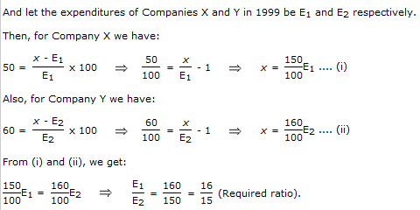
exercise

Slide 49
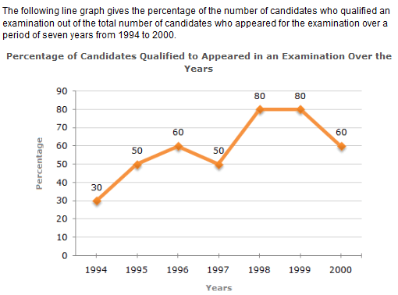
example

Slide 50
example
The difference between the percentage of candidates qualified to appeared was maximum in which of the following pairs of years?

Slide 51
example
example
In which pair of years was the number of candidates qualified, the same?

Slide 52
example
If the number of candidates qualified in 1998 was 21200, what was the number of candidates appeared in 1998?

Slide 53
example
If the total number of candidates appeared in 1996 and 1997 together was 47400, then the total number of candidates qualified in these two years together was?

Slide 54
example
The total number of candidates qualified in 1999 and 2000 together was 33500 and the number of candidates appeared in 1999 was 26500. What was the number of candidates in 2000?

